Slide 1
Deep learning of structure-preserving coarse graining models
Quercus Hernández, Nat Trask
ENM 5320: Ai4science / Science4Ai

Slide 2
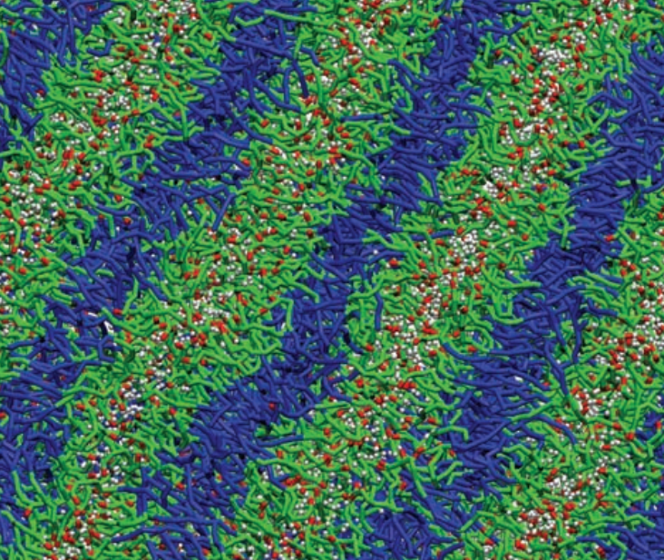
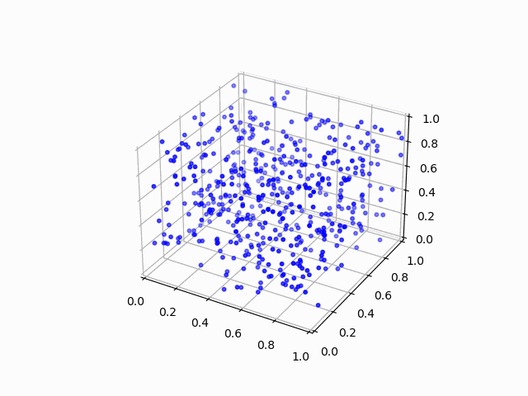
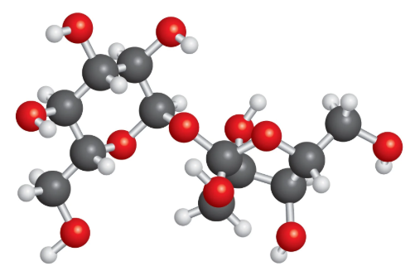
Motivation
Coarse-graining of MD systems
Mesoscale
~1,000
LAMMPS
~1,000,000
Microscale

Slide 3
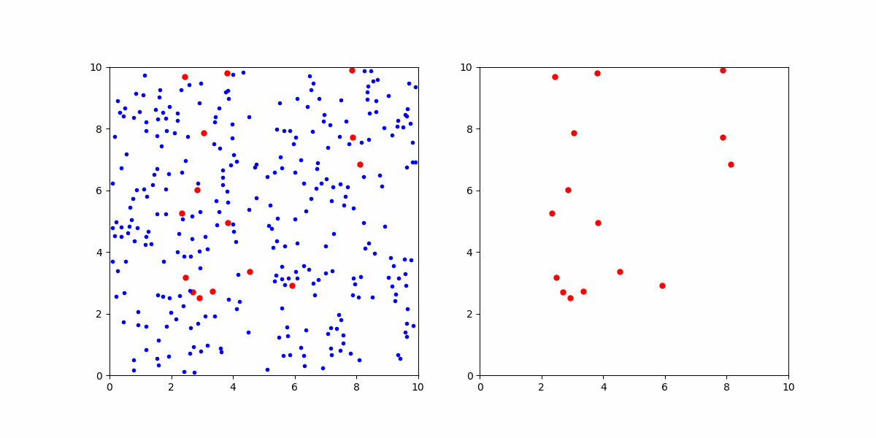
Motivation
Intuition: Particles immersed in fluid
Brownian
Motion!

Slide 4
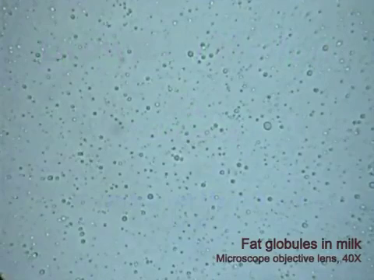
Motivation
Intuition: Particles immersed in fluid
Brownian
Motion!

Slide 5
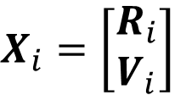
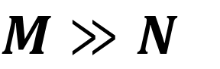
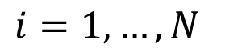
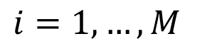
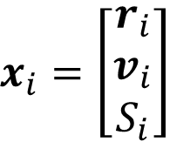
Problem statement
Coarse-graining of complex molecular systems
$$M≫N$$
?
?
$$x_{i}=\left[\begin{matrix}r_{i} \\ v_{i} \\ S_{i}\end{matrix}\right]$$
$$X_{i}=\left[\begin{matrix}R_{i} \\ V_{i}\end{matrix}\right]$$
Full-order
model
Coarse-grained
model
$$i=1,…,M$$
$$i=1,…,N$$

Slide 6
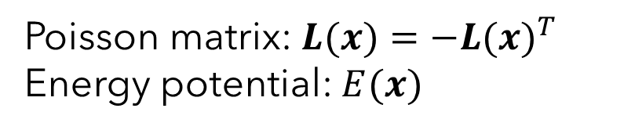
Problem statement
Mathematical framework: GENERIC
[Grmela, PRE‘97]
$$dx=\left(L∇E+M∇S\right)dt$$
Conservative
Poisson matrix: $L(x)=−{L(x)}^{T}$
Energy potential: $E(x)$

Slide 7

Problem statement
Mathematical framework: GENERIC
[Grmela, PRE‘97]
$$dx=\left(L∇E+M∇S\right)dt$$
Dissipative
Friction matrix: $M(x)={M(x)}^{T}≽0$
Entropy potential: $S(x)$

Slide 8

Problem statement
Mathematical framework: GENERIC
[Grmela, PRE‘97]
$$dx=\left(L∇E+M∇S\right)dt$$
Energy conservation: $dE=0$
Entropy inequality: $dS≥0$
Thermodynamical guarantees
Structure preservation
[Hernandez, JCP’20]
[Gruber, NeurIPS’24]

Slide 9
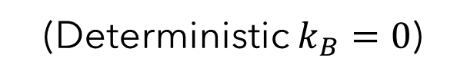
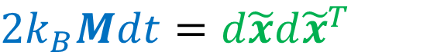
Problem statement
Mathematical framework: GENERIC
[Grmela, PRE‘97]
$$dx=\left(L∇E+M∇S+k_{B}∇⋅M\right)dt+d\tilde{x}$$
Dissipative
Noise
Fluctuation-Dissipation Theorem
$$2k_{B}Mdt=d\tilde{x}d{\tilde{x}}^{T}$$
[Kubo, ROPP‘66]
(Deterministic $k_{B}=0$)

Slide 10
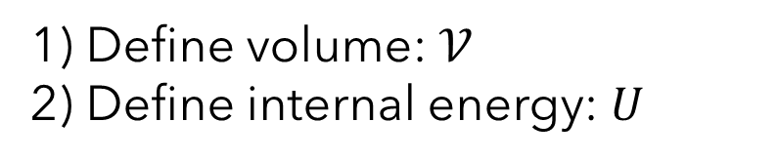
Problem statement
Roadmap
$$dx=\left(L∇E+M∇S+k_{B}∇⋅M\right)dt+d\tilde{x}$$
Conservative
1) Define volume: $𝒱$
2) Define internal energy: $U$

Slide 11
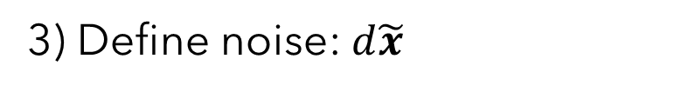
Problem statement
Roadmap
$$dx=\left(L∇E+M∇S+k_{B}∇⋅M\right)dt+d\tilde{x}$$
Dissipative
Noise
$$2k_{B}Mdt=d\tilde{x}d{\tilde{x}}^{T}$$
3) Define noise: $d\tilde{x}$

Slide 12
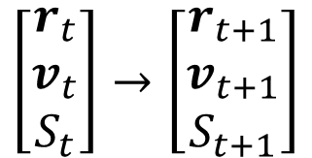
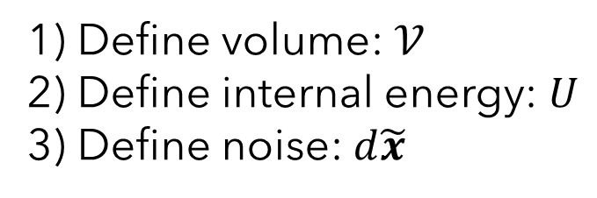
Problem statement
Roadmap
$$dx=\left(L∇E+M∇S+k_{B}∇⋅M\right)dt+d\tilde{x}$$
1) Define volume: $𝒱$
2) Define internal energy: $U$
3) Define noise: $d\tilde{x}$
4) Euler-Maruyama
5) Loss function: NLL
$$\left[\begin{matrix}r_{t} \\ v_{t} \\ S_{t}\end{matrix}\right]→\left[\begin{matrix}r_{t+1} \\ v_{t+1} \\ S_{t+1}\end{matrix}\right]$$

Slide 13
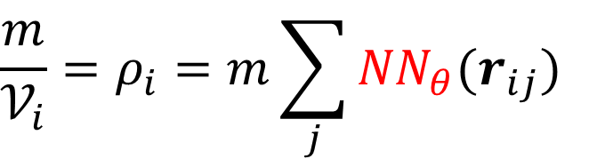
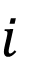
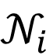
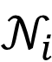
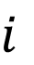
Conservative dynamics
Volume definition
$$\frac{m}{𝒱_{i}}=ρ_{i}=m\sum_{j}{{NN}_{θ}(r_{ij})}$$
Kernel
GAT
E(3)-GNN
$$i$$
$$i$$
$$𝒩_{i}$$
$$𝒩_{i}$$
High density
Low density

Slide 14
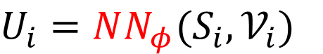
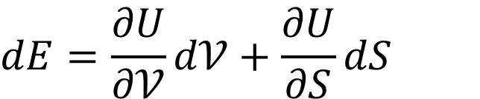
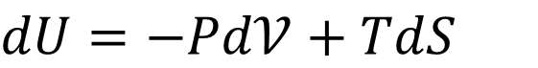
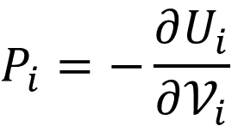
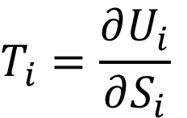
Conservative dynamics
What’s internal energy?
$$dE=\frac{∂U}{∂𝒱}d𝒱+\frac{∂U}{∂S}dS$$
$$dU=−Pd𝒱+TdS$$
$$P_{i}=−\frac{∂U_{i}}{∂𝒱_{i}}$$
$$U_{i}=NN_{φ}(S_{i},𝒱_{i})$$
Equation of State
$$T_{i}=\frac{∂U_{i}}{∂S_{i}}$$

Slide 15
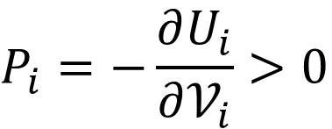
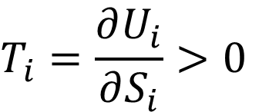
Conservative dynamics
What’s internal energy?
$$dE=\frac{∂U}{∂𝒱}d𝒱+\frac{∂U}{∂S}dS$$
$$dU=−Pd𝒱+TdS$$
$$P_{i}=−\frac{∂U_{i}}{∂𝒱_{i}}>0$$
+ Convex
$$U_{i}=NN_{φ}(S_{i},𝒱_{i})$$
$$T_{i}=\frac{∂U_{i}}{∂S_{i}}>0$$
Constrained Monotonic Neural Networks
[Runje, ICML’23]

Slide 16
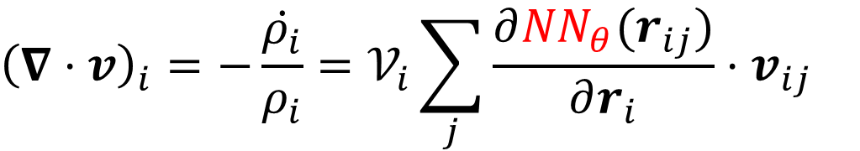
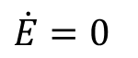
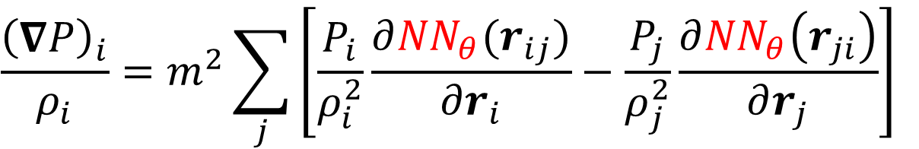
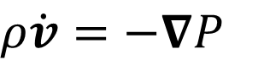
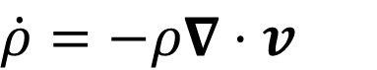
Conservative dynamics
Euler’s equations
Conservation of mass
Conservation of momentum
$${\left(∇⋅v\right)}_{i}=−\frac{\dot{ρ_{i}}}{ρ_{i}}=𝒱_{i}\sum_{j}{\frac{∂{NN}_{θ}(r_{ij})}{∂r_{i}}⋅v_{ij}}$$
$$\dot{ρ}=−ρ∇⋅v$$
$$\frac{{\left(∇P\right)}_{i}}{ρ_{i}}=m^{2}\sum_{j}{\left[\frac{P_{i}}{ρ_{i}^{2}}\frac{∂{NN}_{θ}(r_{ij})}{∂r_{i}}−\frac{P_{j}}{ρ_{j}^{2}}\frac{∂{NN}_{θ}\left(r_{ji}\right)}{∂r_{j}}\right]}$$
$$ρ\dot{v}=−∇P$$
$$\dot{E}=0$$

Slide 17
Conservative dynamics
Idea
$$dx=\left(L∇E+M∇S+k_{B}∇⋅M\right)dt+d\tilde{x}$$
Conservative
1) Define volume: $𝒱$
2) Define internal energy: $U$
✓

Slide 18
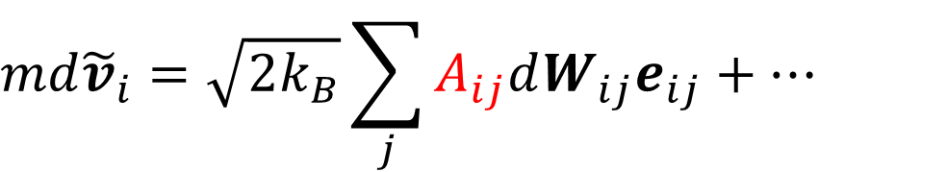
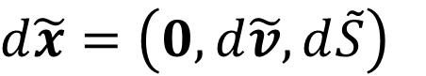
Stochastic dynamics
Noise ansatz
[Espanol, PRE’03]
$$md{\tilde{v}}_{i}=\sqrt{2k_{B}}\sum_{j}{A_{ij}dW_{ij}e_{ij}+…}$$
$$d\tilde{x}=\left(0,d\tilde{v},d\tilde{S}\right)$$

Slide 19
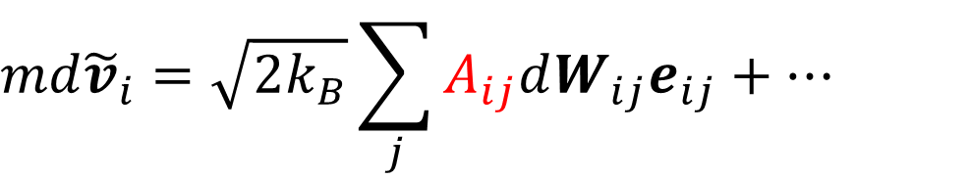
Stochastic dynamics
$$A_{ij}={NN}_{ω}\left({|r}_{ij}|, T_{i}\right)⋅NN_{ω}\left({|r}_{ij}|, T_{j}\right)$$
Noise ansatz
[Espanol, PRE’03]
Symmetric coefficients
$$md{\tilde{v}}_{i}=\sqrt{2k_{B}}\sum_{j}{A_{ij}dW_{ij}e_{ij}+…}$$
$$d\tilde{x}=\left(0,d\tilde{v},d\tilde{S}\right)$$

Slide 20
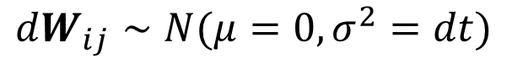
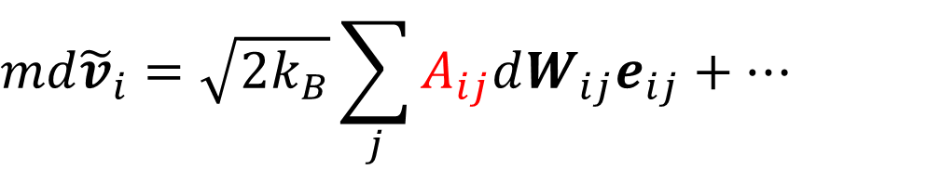
Stochastic dynamics
$$dW_{ij}∼N(μ=0,σ^{2}=dt)$$
Noise ansatz
[Espanol, PRE’03]
Stochastic differentials
$$md{\tilde{v}}_{i}=\sqrt{2k_{B}}\sum_{j}{A_{ij}dW_{ij}e_{ij}+…}$$
$$d\tilde{x}=\left(0,d\tilde{v},d\tilde{S}\right)$$

Slide 21
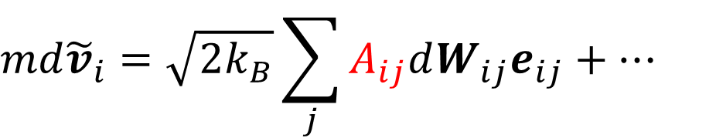
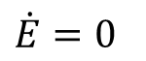
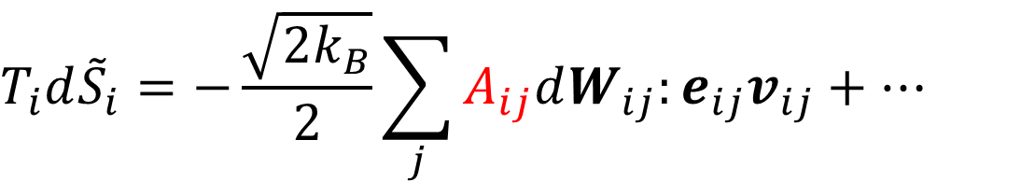
Stochastic dynamics
Noise ansatz
[Espanol, PRE’03]
$$md{\tilde{v}}_{i}=\sqrt{2k_{B}}\sum_{j}{A_{ij}dW_{ij}e_{ij}+…}$$
$$d\tilde{x}=\left(0,d\tilde{v},d\tilde{S}\right)$$
$$\dot{E}=0$$
$$T_{i}d{\tilde{S}}_{i}=−\frac{\sqrt{2k_{B}}}{2}\sum_{j}{A_{ij}dW_{ij}:e_{ij}v_{ij}+…}$$

Slide 22
Stochastic dynamics
Idea
$$dx=\left(L∇E+M∇S+k_{B}∇⋅M\right)dt+d\tilde{x}$$
Dissipative
Noise
$$2k_{B}Mdt=d\tilde{x}d{\tilde{x}}^{T}$$
3) Define noise: $d\tilde{x}$
✓

Slide 23
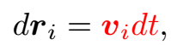
Summary
Forward model

Slide 24
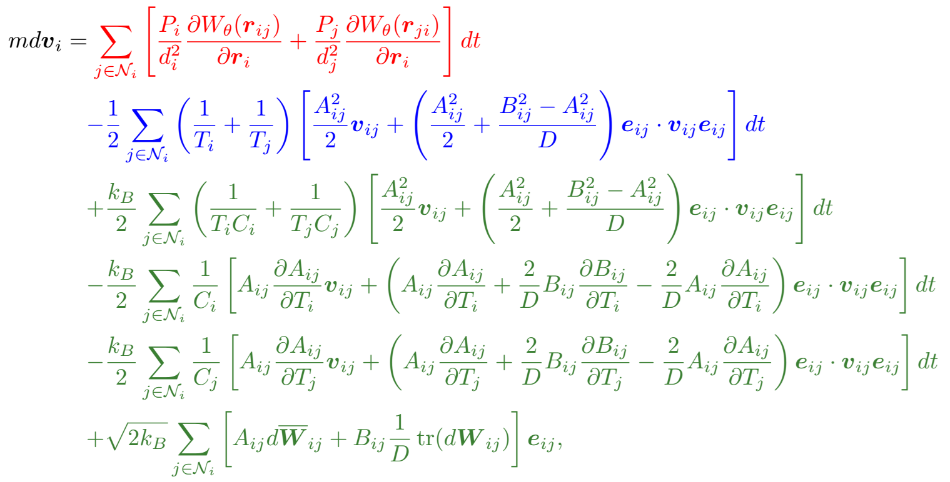
Summary
Forward model

Slide 25
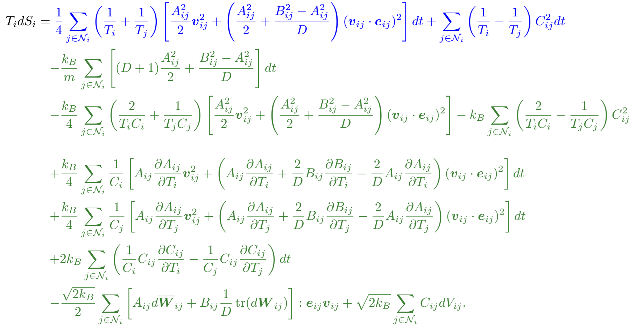
Summary
Forward model

Slide 26
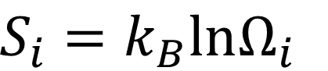
Entropy estimation
$$S_{i}=k_{B}lnΩ_{i}$$
Entropy of a measured system?
$$M≫N$$
?
✓
$$x_{i}=\left[\begin{matrix}r_{i} \\ v_{i} \\ S_{i}\end{matrix}\right]$$
$$X_{i}=\left[\begin{matrix}R_{i} \\ V_{i}\end{matrix}\right]$$
Full-order
model
Coarse-grained
model
$$i=1,…,M$$
$$i=1,…,N$$

Slide 27
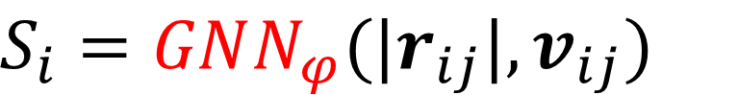
Entropy estimation
$$S_{i}=GNN_{φ}(|r_{ij}|,v_{ij})$$
Entropy of a measured system?
$$M≫N$$
✓
✓
$$x_{i}=\left[\begin{matrix}r_{i} \\ v_{i} \\ S_{i}\end{matrix}\right]$$
$$X_{i}=\left[\begin{matrix}R_{i} \\ V_{i}\end{matrix}\right]$$
Full-order
model
Coarse-grained
model
$$i=1,…,M$$
$$i=1,…,N$$

Slide 28
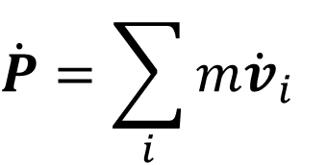
Conservation laws
Properties
Proposition: This algorithm satisfies momentum conservation.
Proof (informal)
Pairwise interactions
Cancellation over index swapping
$$\dot{P}=\sum_{i}{m{\dot{v}}_{i}}$$

Slide 29
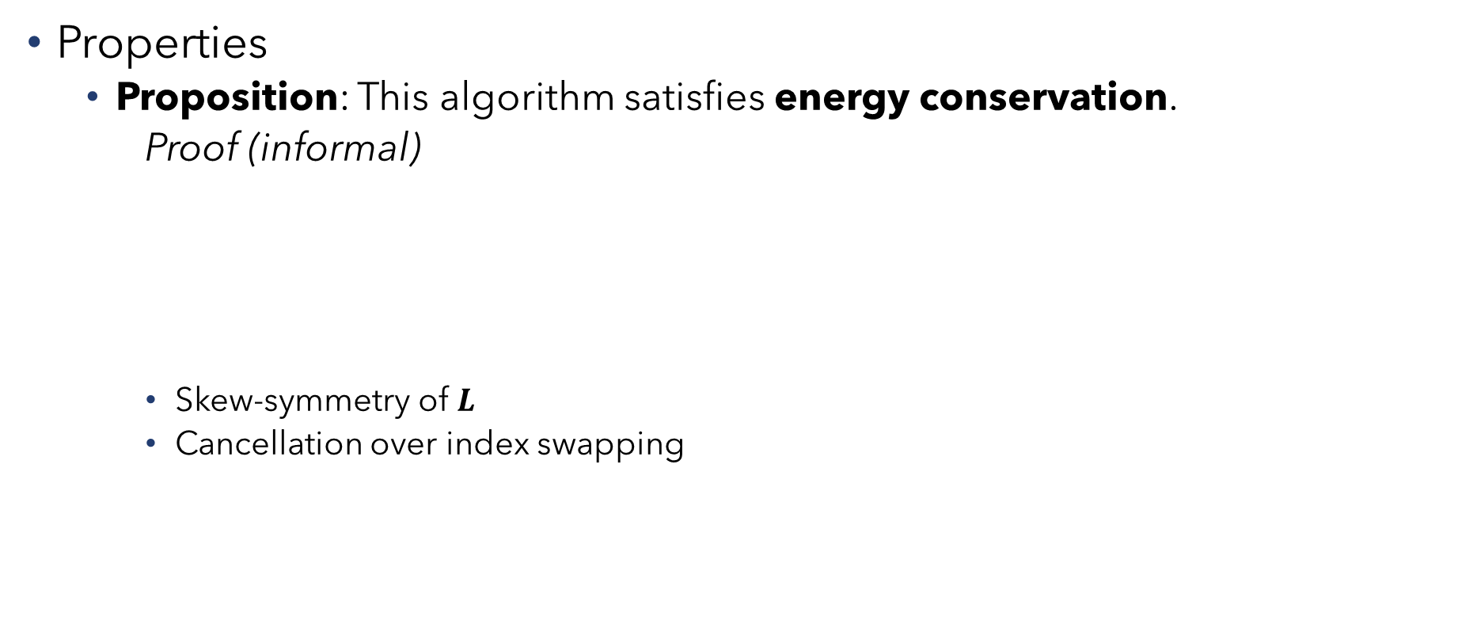
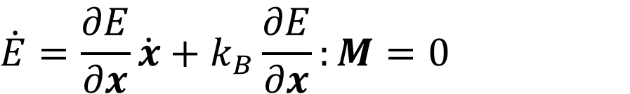

Conservation laws
Properties
Proposition: This algorithm satisfies energy conservation.
Proof (informal)
Skew-symmetry of $L$
Cancellation over index swapping
$$dE=\frac{∂E}{∂x}dx+\frac{1}{2}\frac{∂E}{∂x}:d\tilde{x}d{\tilde{x}}^{T}$$
$$\dot{E}=\frac{∂E}{∂x}\dot{x}+k_{B}\frac{∂E}{∂x}:M=0$$

Slide 30



Conservation laws
Properties
Proposition: This algorithm satisfies entropy inequality if $k_{B}=0$.
Proof (informal)
Positive semidefinitness of $M$
Trivial cancellations (degeneracies)
$$dS=\frac{∂S}{∂x}dx$$
$$\dot{S}=\frac{∂S}{∂x}\dot{x}≥0$$

Slide 31


Training procedure
Euler-Maruyama discretization
$$dx=\left(L∇E+M∇S+k_{B}∇⋅M\right)dt+d\tilde{x}$$
$$Δx=\left(L∇E+M∇S+k_{B}∇⋅M\right)Δt+Δ\tilde{x}$$
$$x_{t+1}=x_{t}+\left(L∇E+M∇S+k_{B}∇⋅M\right)Δt+Δ\tilde{x}$$
$$μ_{t+1}$$
$$Σ_{t+1}=Δ\tilde{x}Δ{\tilde{x}}^{T}=2k_{B}MΔt$$

Slide 32

Training procedure
Negative Log Likelihood
$$ℒ=\sum_{t=0}^{T}{\left[\frac{1}{2}\ln\left|Σ_{t+1}\right|+\frac{1}{2}{\left(x_{t+1}−μ_{t+1}\right)}^{T}Σ_{t+1}^{−1}\left(x_{t+1}−μ_{t+1}\right)\right]}$$

Slide 33


Results
Ideal gas
Equation of State
$N=500$ particles
Taylor-Green forcing
$$U(S,V)=\frac{3}{4π}{\left(\frac{N}{V}\right)}^{\frac{2}{3}}e^{\frac{2S−5}{3}}$$

Slide 34


Results
$$t=500→t=10,000$$
Ideal gas
Time evolution
x20 extrapolation rollout

Slide 35

Results
Ideal gas
Statistics

Slide 36


Results
Ideal gas
Boundary coditions extrapolation

Slide 37


Results
Star polymer
11 monomers
$N=1,000$ polymers

Slide 38

Results
Star polymer
Statistics

Slide 39

Results
Scalability
LAMMPS implementation
Weak scaling

Slide 40

Results
Other methods
Message-passing GNN
SDE learning
[Sanchez-Gonzalez, ICML’20]
[Dridi, EUSIPCO’21]

Slide 41
Conclusions
Machine-learnable coarse graining
Structure-preserving
Light-weight architecture
Extrapolation capabilities
Long rollouts
BCs
Scalable HPCs: 1,000,000 particles

Slide 42

Conclusions
Machine-learnable coarse graining
Structure-preserving
Light-weight architecture
Extrapolation capabilities
Long rollouts
BCs
Scalable HPCs: 1,000,000 particles
Future work
Measured MD data
Conditioning

Slide 43



Deep learning of structure-preserving coarse graining models
Quercus Hernández, Nat Trask
ENM 5320: Ai4science / Science4Ai
quercushernandez@gmail.com
@QuercusEtAl
github.com/quercushernandez
github.quercushernandez.io

Slide 44
Deep learning of structure-preserving coarse graining models
Quercus Hernández, Nat Trask
ENM 5320: Ai4science / Science4Ai
quercushernandez@gmail.com
@QuercusEtAl
github.com/quercushernandez
github.quercushernandez.io

Slide 45

Motivation
Coarse-graining of complex molecular systems

Slide 46

Summary
4 small networks
$𝒱_{i}=GNN_{θ}({|r}_{ij}|)$
$U_{i}=MonotonicNN_{φ}\left(S_{i},𝒱_{i}\right)$
$A_{ij}=MLP_{ω}({|r}_{ij}|,T_{i})·MLP_{ω}({|r}_{ij}|,T_{j})$
$S_{i}=GNN_{φ} ({|r}_{ij}|,v_{ij})$
Shared between nodes and edges
Structure preservation by construction
$$dP=0, dE=0, dS≥0$$

Slide 47

Training procedure
Negative Log Likelihood
$$ℒ=\sum_{t=0}^{T}{\left[\frac{1}{2}\ln\left|Σ_{t+1}\right|+\frac{1}{2}{\left(x_{t+1}−μ_{t+1}\right)}^{T}Σ_{t+1}^{−1}\left(x_{t+1}−μ_{t+1}\right)\right]}$$
Global Covariance: $Σ∼\left[1,N(2D+1),N(2D+1)\right]$ $∼O(N^{2})$
✓
Marginal Covariances: $Σ_{ii}∼[N, 2D+1, 2D+1]∼O(N)$

Slide 48

Results
Time performance
Speed-up

